Slide 1
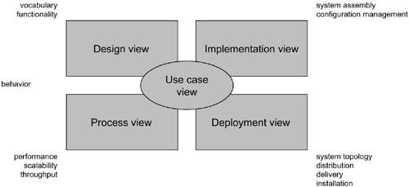
Modeling a System's Architecture

Slide 2
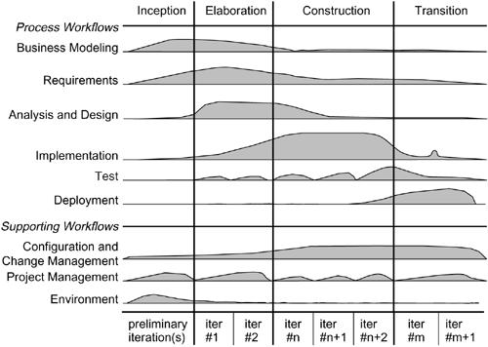
Software Development Life Cycle

Slide 3
Typically, we'll view the static parts of a system using one of the four following diagrams:
1. Class diagram
2. Object diagram
3. Component diagram
4. Deployment diagram

Slide 4
We'll often use five additional diagrams to view the dynamic parts of a system:
1. Use case diagram
2. Sequence diagram
3. Collaboration diagram
4. Statechart diagram
5. Activity diagram

Slide 5
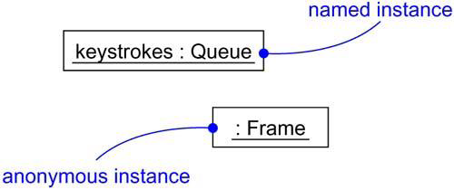
Instances

Slide 6
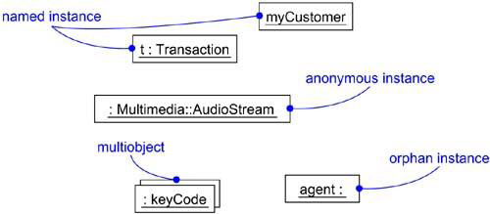
Named, Anonymous, Multiple, and Orphan Instances

Slide 7
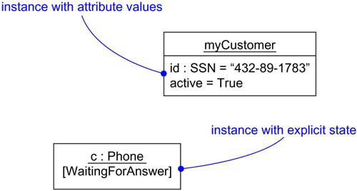
Object State

Slide 8
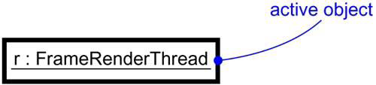
Active Objects

Slide 9
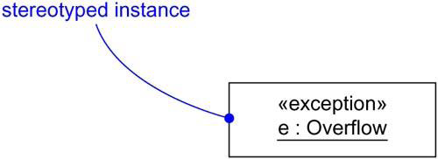
Stereotyped Objects

Slide 10
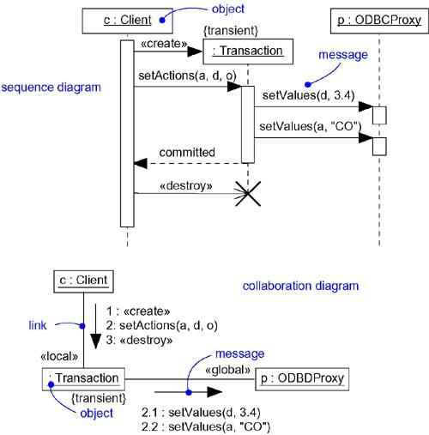
Interaction Diagrams

Slide 11
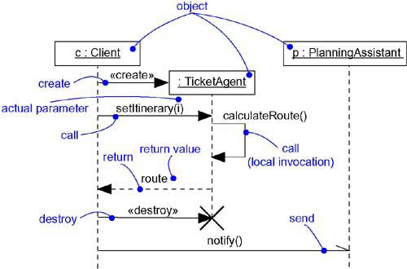
Messages

Slide 12
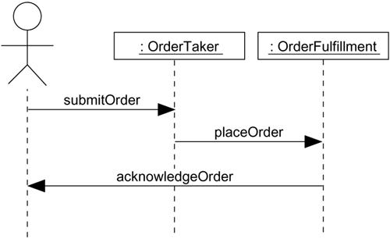
Interaction Diagram at a High Level of Abstraction

Slide 13
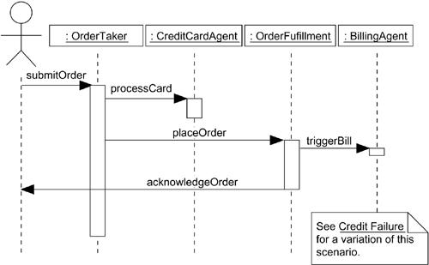
Interaction at a Low Level of Abstraction

Slide 14
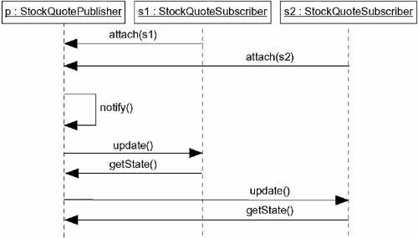
Flow of Control by Time

Slide 15
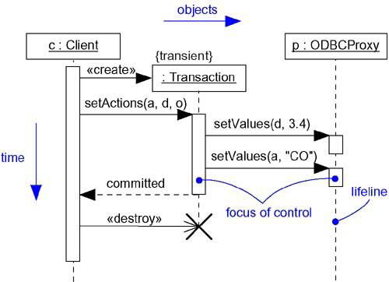
Sequence Diagram

Slide 16
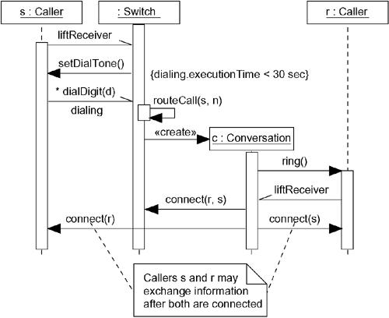
Modeling Flows of Control by Time Ordering/Sequence Diagram

